Slide 1
Session 6D - The Bullwhip Effect In Supply Chains
G Krishnamurthy
MGT 321
Wed, Nov 6 - Thu, Nov 7, 2024

Slide 2
The Bullwhip Effect in Supply Chains
G Krishnamurthy
Thu, 6-Apr-2017

Slide 3
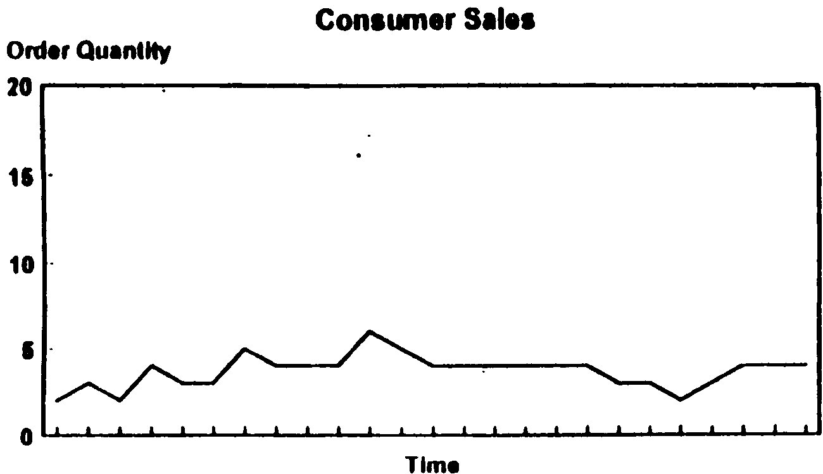
Retailer Variability In Sales

Slide 4
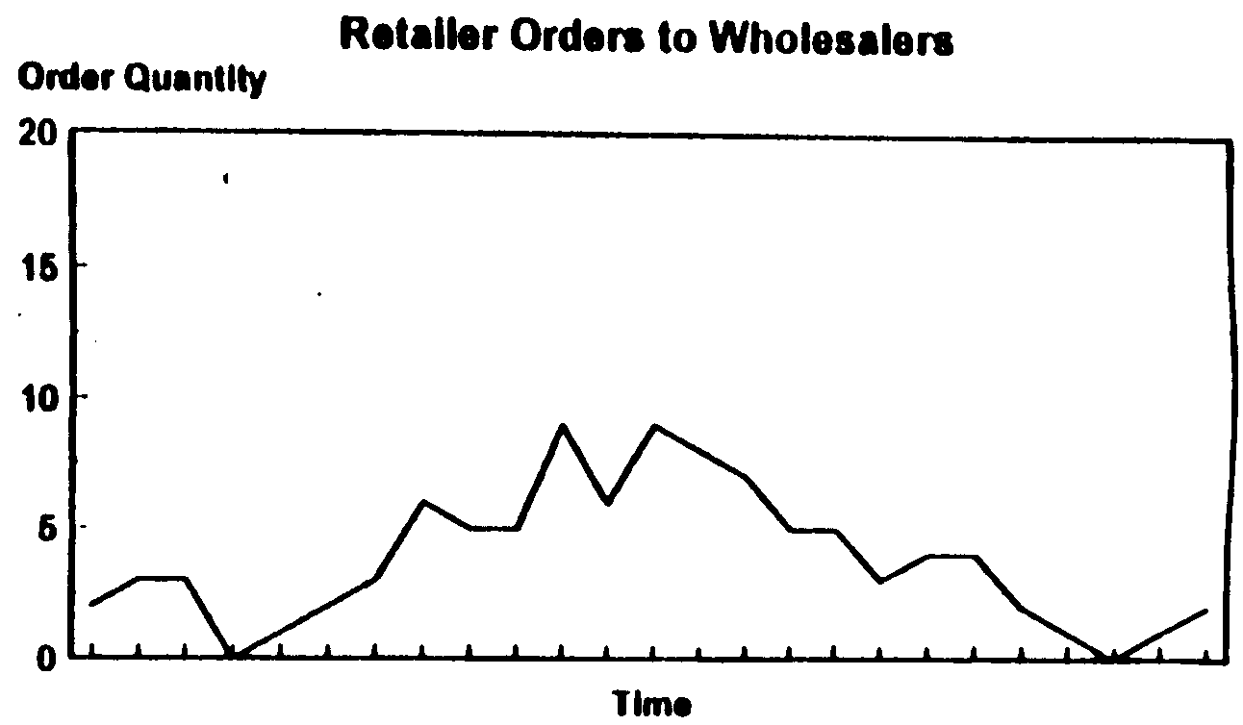
Wholesaler Variability

Slide 5
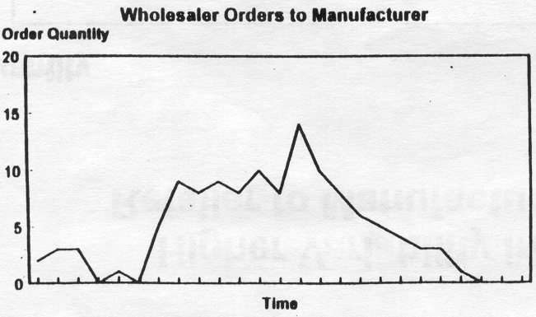
Manufacturer Variability

Slide 6
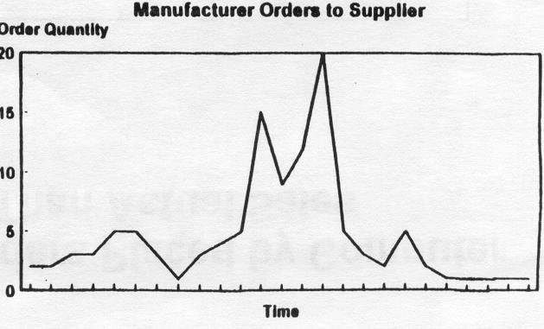
Supplier Variability

Slide 7
Increasing Variability of Orders Up the Supply Chain
Lee, H, P. Padmanabhan and S. Wang (1997), Sloan Management Review

Slide 8
Finding ….
Increase in variability as one travels upstreams in the supply chain ….Bullwhip Effect

Slide 9
What are the Causes….
Promotional sales (P&G)
Volume and Transportation Discounts
Inflated orders
- IBM Aptiva orders increased by 2-3 times when retailers though that IBM would be out of stock over Christmas
- Same with Motorola’s Cellular phones
Demand Forecast
Long cycle times

Slide 10
We Conclude ….
Order Variability is amplified up the supply chain; upstream echelons face higher variability.
What you see is not what they face.

Slide 11
Consequences….
Increased safety stock
Reduced service level
Inefficient allocation of resources
Increased transportation costs

Slide 12
The Bullwhip Effect:
Managerial Insights
Exists, in part, due to the retailer’s need to estimate the mean and variance of demand.
The increase in variability is an increasing function of the lead time.
The more complicated the demand models and the forecasting techniques, the greater the increase.
Centralized demand information can reduce the bullwhip effect but will not eliminate it.

Slide 13
Coping with the Bullwhip Effect in Leading Companies
Reduce Variability and Uncertainty
- POS
- Sharing Information
- Year-round low pricing
Reduce Lead Times
- EDI
- Cross Docking
Alliance Arrangements
  Vendor managed inventory
  On-site vendor representatives

Slide 14
Beer Game And Its Consequences
Install A T Kearney’s Beer Game and try out the bullwhip effect
After testing your values, please summarize:
  Impact of increase in sales duration
  Impact of increase in shipping delay
  Impact of increase in inventory coverage time
  Impact of increase in inventory adjustment time

Slide 15
Thank You

